Slide 1

Empowering Learners with AI
Jenny Li, Viviana Martinez, Ana Nguyen, Cecilia Wu

Slide 2
Agenda
01
Intro
02
Needfinding
03
Interview Results
04
Analysis
05
Summary

Slide 3



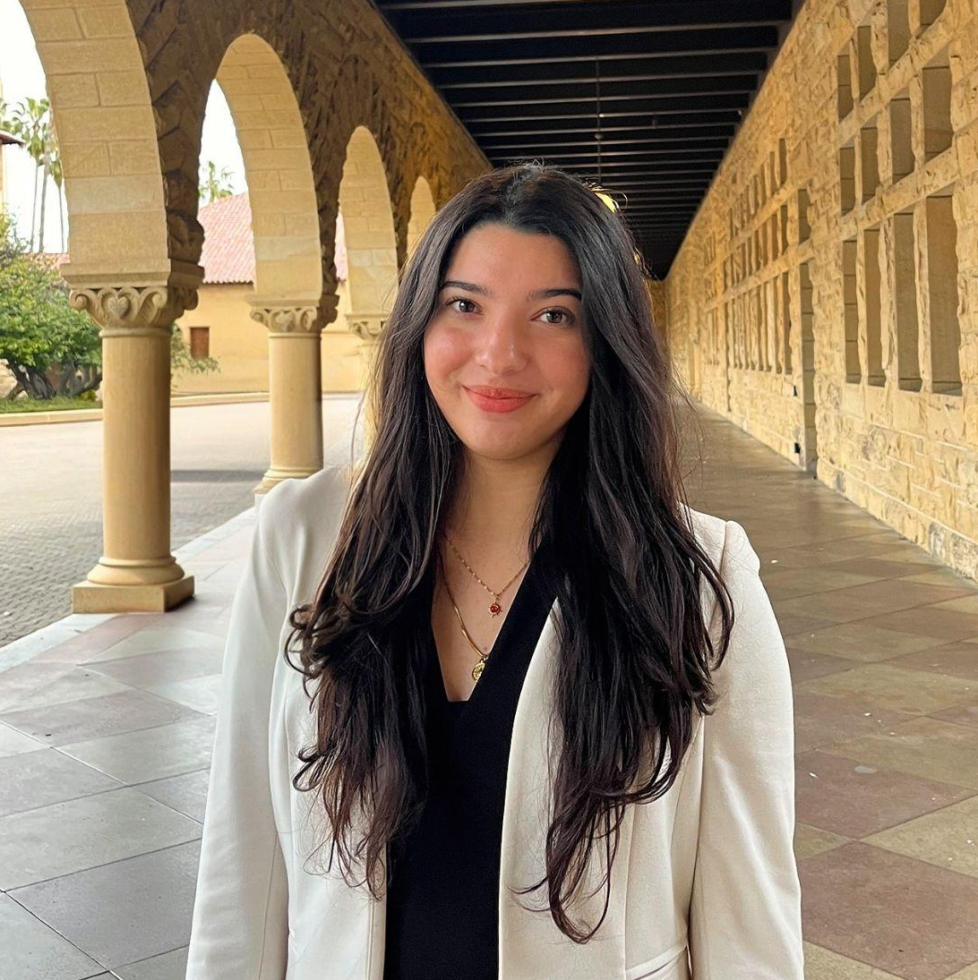
Our Team
Jenny Li
Cecilia Wu
Ana Nguyen
Viviana Martinez
Computer Science
Guangzhou, China
Computer Science
Portland, Oregon
Computer Science
Torrance, CA
Computer Science
Laredo, TX

Slide 4
Domain Selection
Self Learning
Multi-
media
Retention
Engagement

Slide 5

Finding Participants
1
2
3
4
We went to the streets.. and coffee shops
Levels of AI adoption
Types of employment
Different Ages
Technology proficiency
Notes:
Team member roles in each interview and apparatuses

Slide 6





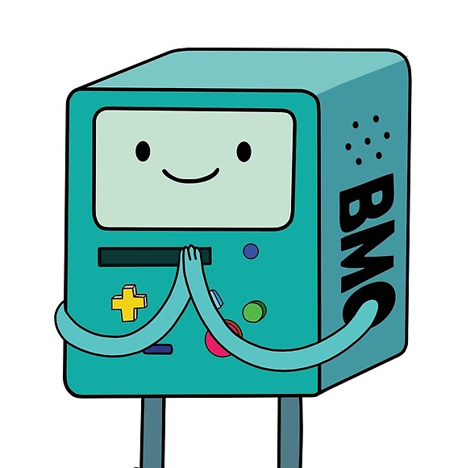
Our Participants
“Gunter”
“Finn”
“Jake”
“BMO”
73 y/o
Records audiobooks
12 y/o
Middle School Student
21 y/o
CivilEng College Student
33 y/o
Works at AI company
Extreme users
Notes:
How were they recruited

Slide 7
Questions
What resources do you use to learn?
“What kinds of opportunities do you have to learn [xyz] outside of school?”
Who do you usually reach out to for help when you get stuck?
What do you think is the best way you learn?
What’s been the hardest part about teaching yourself?
What kind of feedback do you find most useful?

Slide 8
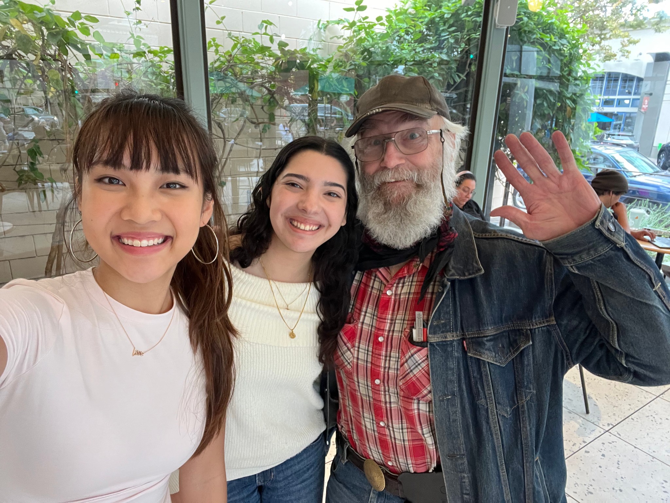
“Gunter”
73 y/o, VA - Audiobooks
“
And so, I went online, and there were three or four different versions of how to pronounce [a last name]. So, finally I gave up, and I just gave it my best shot, and I figured, well, whoever listens to it, if they are going to argue with me, then I'll listen to their argument, but I probably won't change it.
Lack of historically accurate resources
Subjective audience
Preference for no feedback

Slide 9
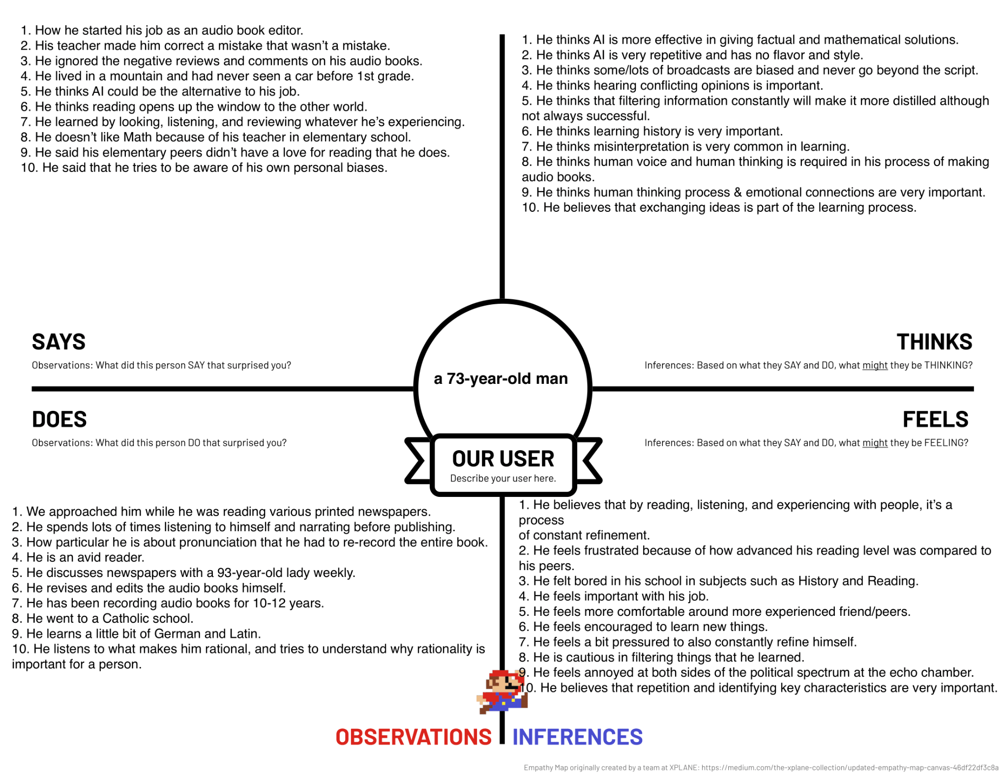

Slide 10
Hearing conflicting opinions is important
Misinterpretation is very common in learning
[I] learn by looking, listening, and reviewing whatever [I’m] experiencing
Reading, listening, and experiencing with people is a process of constant refinement
He reads various printed newspapers at the same time
Feels comfortable around more experienced friends/peers

Slide 11
Key Insights
Insights
Needs
Learning is an iterative process of refinement that depends on exposure to multiple perspectives
Values discussion and diverse viewpoints
Misinterpretation is common without clarification
He needs reliable opportunities for dialogue and comparison of perspectives with more knowledgeable peers or mentors
Notes:
so he can resolve misunderstandings, refine his thinking, and build deeper comprehension

Slide 12
“Finn”
12 y/o, Middle School Student
“
I think this goes for a lot of kids. But I feel like there's a couple of people that like target me and some of my friends. Like when I didn't really do something bad.
Feels targeted
Relies on friends
Wants to feel accomplished

Slide 13
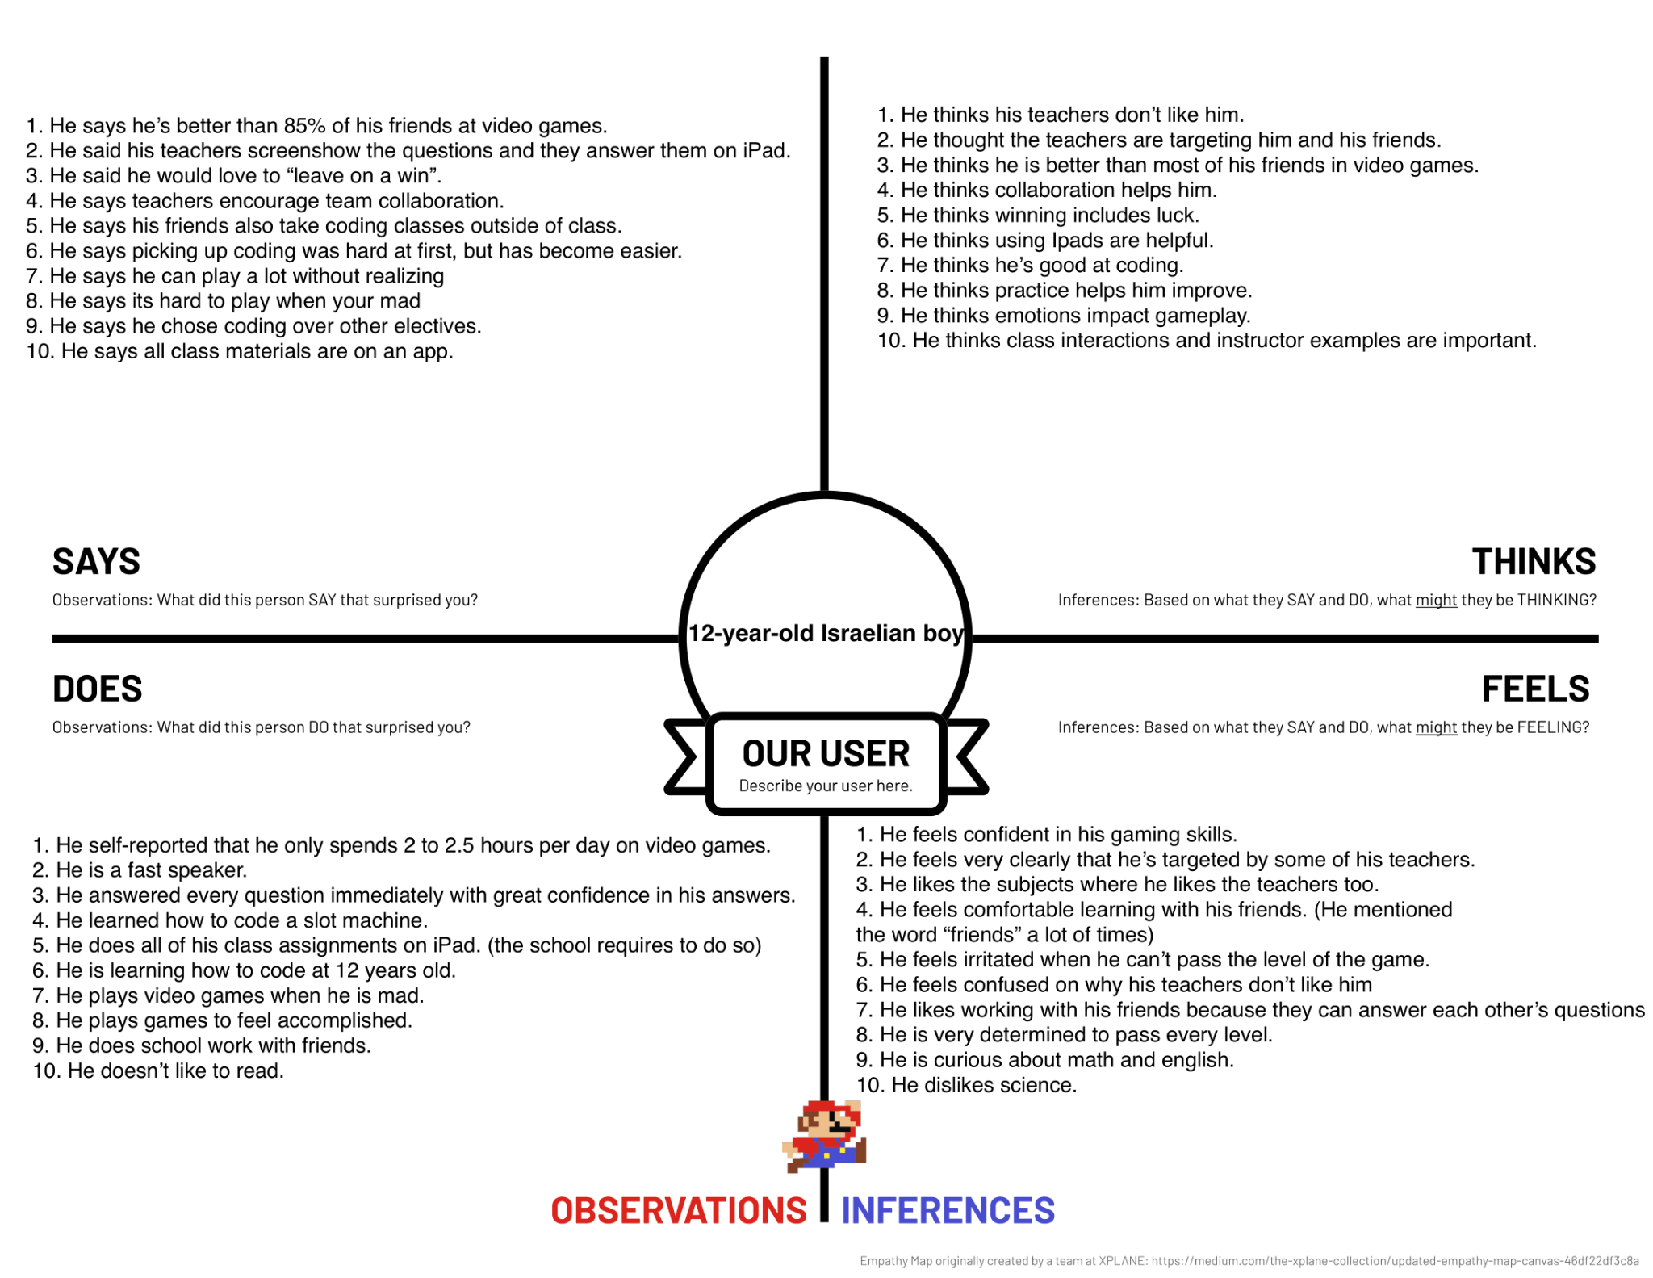

Slide 14
Teachers target him + friends
Collaboration helps him
Feels comfortable working with friends
Enjoys working with friends because they can answer each other’s questions

Slide 15
Key Insights
Insights
Needs
Finn fosters an “us” vs “them” mentality between his peers and teachers
He needs a safe, collaborative learning environment where peer interaction is encouraged and supported

Slide 16
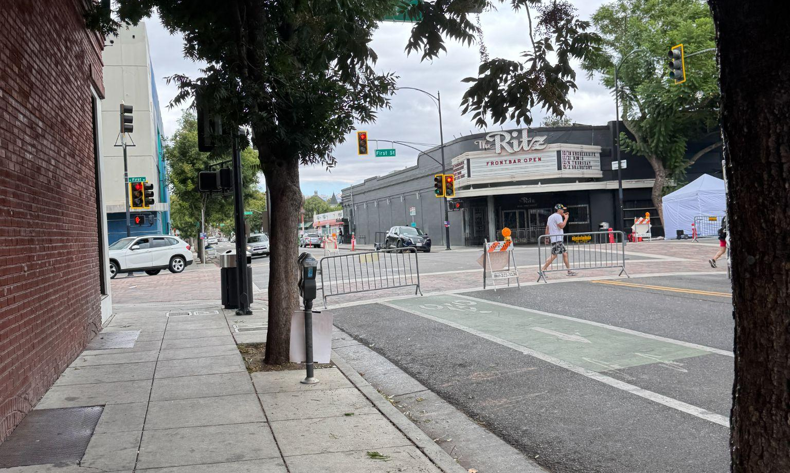
“Jake”
21 y/o, CivilEng College Student
“
The main issue is lack of feedback. I wish I had easier access to learning what I like to learn. It’s been a lot of throwing my head against the wall.”
Street in San Jose
Depth of independence
Hyper-fixation on projects
Isolation → resourcefulness

Slide 17
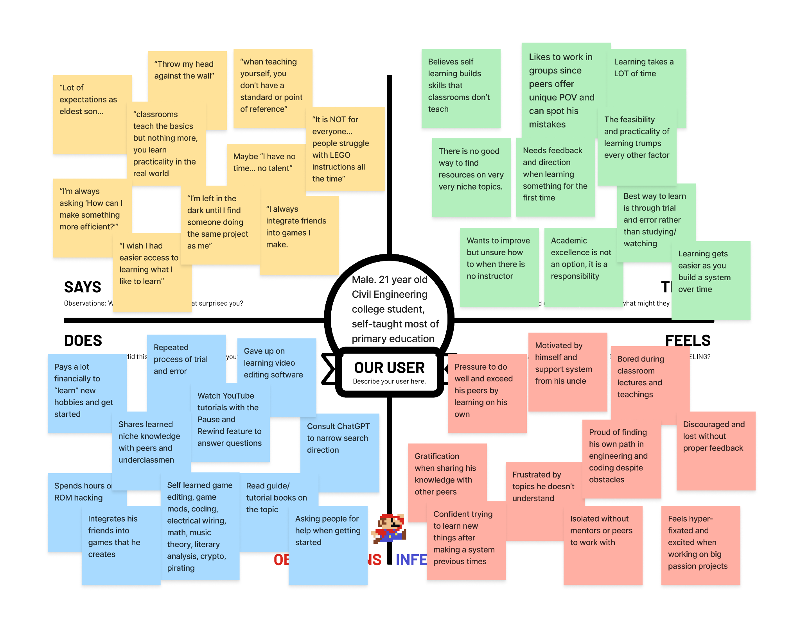

Slide 18
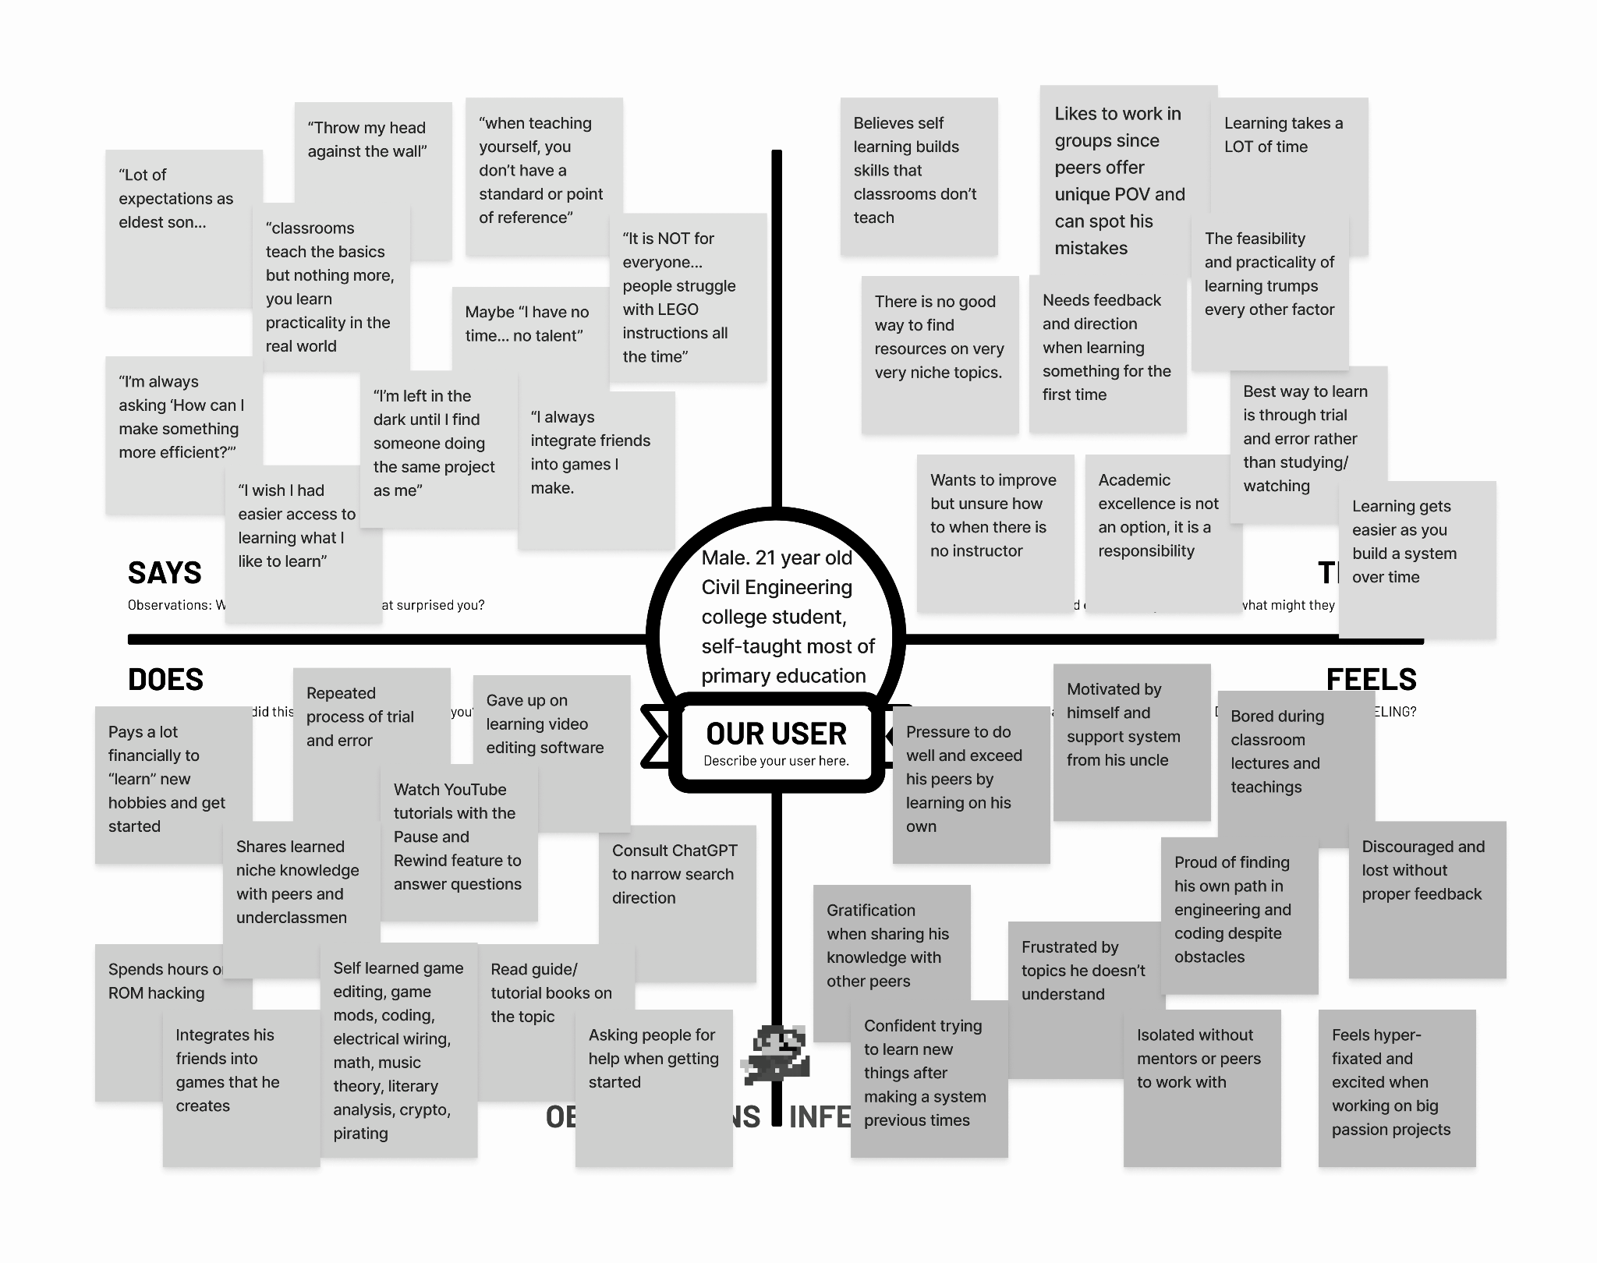
Throw my head against the wall
There is no good way to find specific resources on very niche topics
I’m left in the dark until I find someone doing the same project as me
Shares learned niche knowledge with peers and underclassmen
Isolated without mentors or peers to work with
Watch YouTube tutorials w/ Pause + Rewind

Slide 19
Key Insights
Insights
Needs
Struggles with isolation and lack of guidance (niche topics)
Progress often feels like trial-and-error until he finds peers tackling similar challenges
Values sharing knowledge once he figures things out
He needs accessible, reliable ways to find support and resources on specialized topics
He needs peer or mentor connections to build confidence and receive feedback

Slide 20
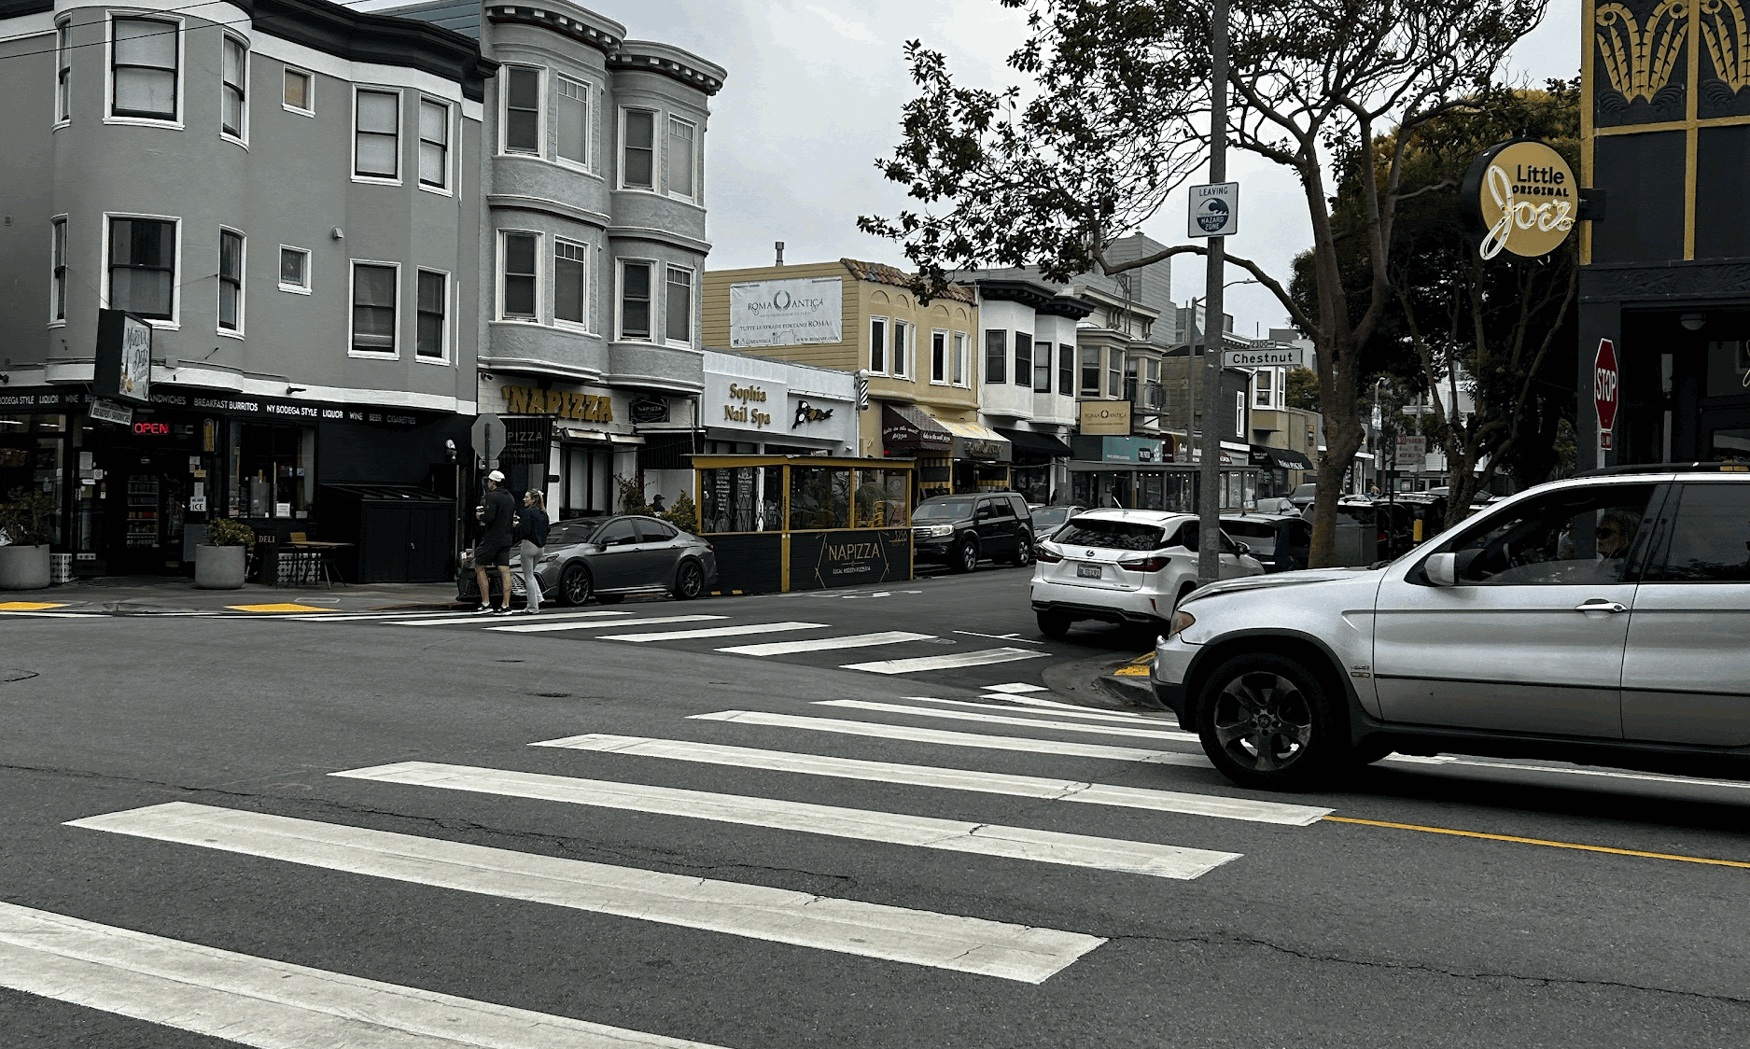
“BMO”
33 y/o, AI company
“
“I realized AI doesn’t mind if I ask ‘dumb’ questions again and again. It made it easier to admit what I didn’t get. But sometimes, prompting feels more like a hassle than help”
Street in San Francisco
Enjoys learning at own pace
Motivating self is hard
Wants AI plus human help

Slide 21
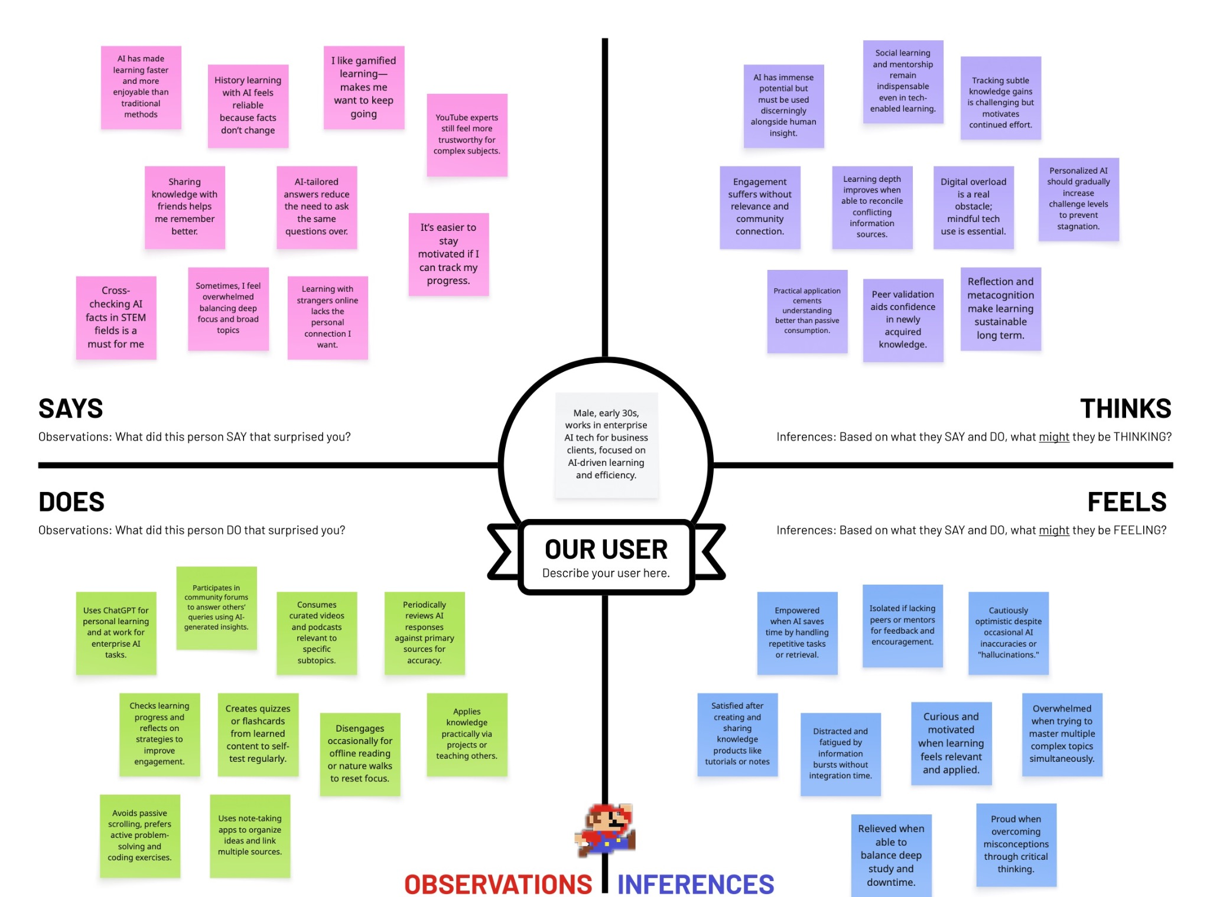

Slide 22
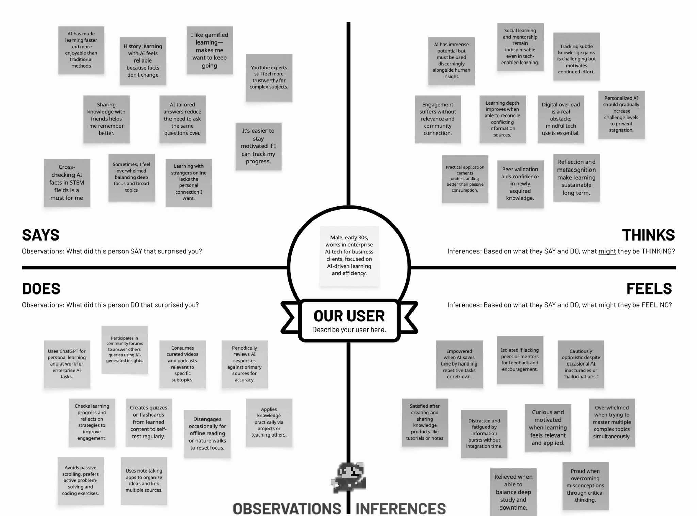
Engagement suffers without relevance and community connection
Learning with strangers online lacks the personal connection I want
Peer validation aids confidence in newly acquired knowledge
Isolated if lacking peers or mentors for feedback
Applies knowledge practically through projects or teaching others.
Satisfied after creating and sharing knowledge products (tutorials, notes)

Slide 23
Key Insights
Insights
Needs
Self-learners…
thrive when they can apply knowledge in practice and share it with others
struggle when missing community relevance
Learning needs to facilitate practical application and sharing of knowledge.
Learning needs to feel relevant, personal, and socially connected

Slide 24
Summary
1
2
3
Learning is social and iterative
Guidance and access to resources → critical
Sharing knowledge leads to more engagement + retention
Safe and supportive environments encourage participation
Narrow down our scope to focus on group collaboration among peers
Interview people to see what types of group collaboration work best
HMW statements, paper prototyping

Slide 25
Thank
you

